Slide 1

Dr. B. R. Ambedkar National Institute of Technology
Biofuel Production using Waste oil
Submitted by: Sahil (22112068)
Saloni Garg (22112070)
Guided by:
Dr. Deepak Sahu
(Assistant Professor)

Slide 2
INTRODUCTION

Slide 3
Fossil fuels are depleting and cause environmental harm (pollution, climate change).
Renewable energy sources (solar, wind, bioenergy, hydrogen) are increasingly adopted.
Plastics and agricultural waste create long-term environmental problems.
Co-pyrolysis offers a sustainable solution by converting biomass and plastic waste into fuel.
Supports circular economy: reduces waste and generates energy.
Need for Waste-to-Energy

Slide 4
Pyrolysis is the process of thermal decomposition without oxygen. It converts organic waste into bio-oil, syngas, and biochar.
Works on plastics, rubber, agricultural waste, etc.
Reduces greenhouse gas emissions and pollution.
Feedstock type and temperature significantly affect product distribution.
What is Pyrolysis?

Slide 5
Co-pyrolysis is the process of simultaneous pyrolysis of biomass and plastic waste.
Benefits:
Lower oxygen content, improved stability
Reduced char, more light hydrocarbons
What is Co-pyrolysis?

Slide 6
Abundantly available from homes and restaurants.
Cost-effective and reduce waste.
Does not compete with food crops.
Promotes circular economy.
FEEDSTOCK SELECTION

Slide 7
Feedstock | Type | Pros | Cons
Waste Cooking Oil (WCO) | Waste/Used Oil | - Cheap or free - Reduces waste - Easily available - Eco-friendly | - Needs pre-treatment - Composition varies - May contain impurities
Soybean Oil | Edible Vegetable Oil | - High oil content - Well-studied process | - Competes with food supply - Higher cost
Palm Oil | Edible Vegetable Oil | - High yield per hectare - Widely available in tropical regions | - Deforestation issues - Competes with food
Rapeseed/Canola Oil | Edible Vegetable Oil | - Good cold flow properties - Popular in Europe | - Expensive - Food vs fuel debate
Sunflower Oil | Edible Vegetable Oil | - Readily available in many countries | - Higher production cost - Competes with food
Animal Fats (e.g., tallow) | Non-Edible Waste | - Inexpensive - Utilizes slaughter waste | - High melting point - Poor cold flow properties
Algae Oil | Non-Edible (Future) | - High yield - Grows on non-arable land - Doesn’t compete with food | - Expensive - Technology not yet commercial
Jatropha Oil | Non-Edible Plant | - Grows on marginal land - Non-food crop | - Toxic - Low and inconsistent yields
Used Industrial Oils | Waste/Non-Food | - Cheap or free - Reduces pollution | - Requires heavy treatment - May have toxic impurities

Slide 8
Sustainable and Green
Low Cost
High Catalytic Activity
Reusability
Eco-Friendly
Catalyst selection
(zinc doped Biochar)

Slide 9
Type of Catalyst | Examples | Type | Pros | Cons
Alkali Catalysts | NaOH, KOH | Homogeneous | - High reaction rate - Low cost | - Difficult to recover - Produces soap with FFA - Not eco-friendly
Acid Catalysts | H₂SO₄, HCl | Homogeneous | - Works with high FFA oils - Prevents soap formation | - Corrosive - Slow reaction rate - Requires long reaction time
Enzyme Catalysts | Lipase | Biocatalyst | - Mild conditions - High specificity | - Expensive - Sensitive to alcohol and temperature
Metal Oxides | ZnO, CaO, MgO | Heterogeneous | - High activity - Reusable - Environmentally safer | - Prone to leaching - Costly for some metals
Bio-waste-based Catalysts | Eggshells, bones, shells | Heterogeneous | - Abundant - Cheap - Renewable | - Impure - Variable quality
Zeolites & Solid Acids | H-ZSM-5, Amberlyst | Heterogeneous | - Good thermal stability - Reusable | - Expensive - Requires complex synthesis
Zinc-Doped Biochar | Biochar from biomass + Zn (ZnO, Zn²⁺) | Heterogeneous | - Cheap & renewable - High surface area - Reusable - Environmentally friendly | - Activity drops slightly after 3–4 uses - Needs pyrolysis setup

Slide 10
This is the chemical reaction that converts oil into biodiesel.
Steps:
Preparation: WCO is filtered to remove impurities.
Reaction:WCO + Methanol + Zinc-doped biochar catalyst is Heated to ~60–65°C for 2–3 hours.Reaction converts triglycerides in oil into Fatty Acid Methyl Esters (FAME) – the main component of biodiesel.
Separation: Mixture separates into two layers:Top: BiodieselBottom: Glycerol + leftover catalyst
Purification:Biodiesel is washed with warm water and dried.
Properties (density, viscosity, flash point, etc.) are tested.
TANSESTERIFICATION

Slide 11
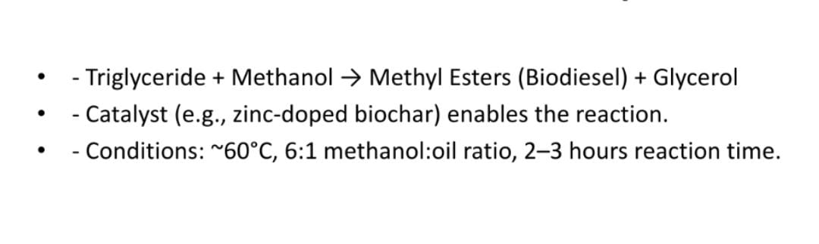
General Reaction Equation

Slide 12
DETAILED PROCESS

Slide 13
Step 1 (Oil Collection and Pretreatment)
COLLECTION: waste cooking oil collected from restaurants or households.
FILTRATION: Removes food particles and solid residues.
DRYING: Removes moisture content to avoid soap formation.
RESULT: clean oil suitable for reaction.

Slide 14
Step 2 (Catalyst Preparation)
Raw Material: Agricultural waste (e.g., rice husk) selected asbiomass.
Pyrolysis: Biomass heated at 400-500°C in absence of oxygen → Biochar.
Zinc Doping: Biochar soaked in zinc nitrate/acetate solution.
Drying and Heating: Catalyst is dried and activated by further heating.
Characterization: XRD, SEM, and EDX used to confirm structure and activity..

Slide 15
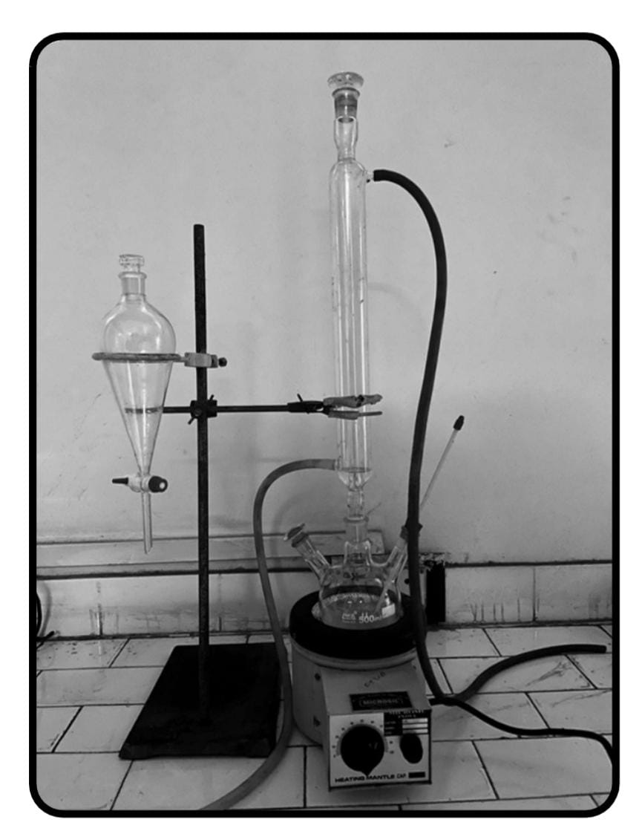
Step 3 (Reaction Setup)
- 3-neck flask setup with condenser, thermometer, and heating mantle.
- Mixture: WCO + Methanol + Zinc-doped biochar.
- Common ratio: 6:1 methanol to oil, 4 wt% catalyst.
- Stirring ensures uniform reaction.

Slide 16
Step 4 (Transesterification Reaction)
Heating mixture to ~60°C for 2-3 hours.
Catalyst enables breakdown of triglycerides.
Reaction yields two phases:
- Upper: Biodiesel (methyl esters)
- Lower: Glycerol and residual catalyst

Slide 17
Step 5 (Separation of Products)
Cooling: Reaction mixture allowed to cool.
Settling: Two phases separate naturally due to density difference.
Separation: Biodiesel (top layer) decanted from glycerol (bottom layer).
Catalyst: Filtered from glycerol and reused

Slide 18
Step 6 (Purification of Biodiesel)
Washing: Biodiesel washed with warm water to remove residuals.
Neutralization: Ensures removal of catalyst and excess alcohol.
Drying: Heated to remove water content.
Final Product: Clean, pure biodiesel ready for testing.

Slide 19
Fuel Quality Analysis
Properties tested: Density, Viscosity, Acid Value, Flash Point.
Meets ASTM D6751 and EN 14214 standards.
Suitable for blending or direct diesel engine use.

Slide 20
Future scope
Using new catalysts
Experimentation with various feedstocks.
Future: Mixed-metal catalysts, continuous reactors, full life cycle analysis

Slide 21
References
Ma & Hanna, Bioresource Tech (1999)
Demirbas, Energy Conv & Mgmt (2009)
ASTM D6751, EN 14214 Standards
More references in the report

Slide 22
THANK YOU!

